Slide 1
Performance
How to measure, report, and summarize performance (suorituskyky, tehokkuus)?
What factors determine the performance of a computer?
Critical to purchase and design decisions
  best performance?
  least cost?
  best performance/cost?
Questions:
Why is some hardware better than others for different programs?
What factors of system performance are hardware related?
(e.g., Do we need a new machine, or a new operating system?)
How does the machine's instruction set affect performance?

Slide 2
Computer Performance
Response Time (execution time) (vasteaika, laskenta-aika)
— The time between the start and completion of a task
Throughput (tuotos)
— The total amount of work done in a given time
Q: If we replace the processor with a faster one, what do we change?
A: Decrease response time and increase throughput
Q: If we add an additional processor to a system, what do we change?
A: Increase throughput
Notes:
Have them raise their hands when
answering questions

Slide 3
Book's Definition of Performance
For some program running on machine X,
Performance_{X} = 1 / Execution time_{X}
"X is n times faster than Y"
n = Performance_{X} / Performance_{Y}
= Execution time_{Y} / Execution time_{X}
Problem: Machine A runs a program in 10 seconds and machine B in 15 seconds. How much faster is A than B?
Answer: n = Performance_{A} / Performance_{B}
= Execution time_{B}/Execution time_{A} = 15/10 = 1.5
  A is 1.5 times faster than B.

Slide 4
Execution Time
Elapsed Time (kulunut/käytetty aika), wall-clock time or response time
  counts everything (disk and memory accesses, I/O , etc.)
  a useful number, but often not good for comparison purposes
CPU time
  doesn't count I/O or time spent running other programs
  can be broken up into system time, and user time
Our focus: user CPU time
  time spent executing the lines of code that are "in" our program

Slide 5
Clock Cycles
Instead of reporting execution time in seconds, we often use cycles
Execution time = # of clock cycles • cycle time
Clock “ticks” indicate when to start activities (one abstraction):
cycle time (period) = time between ticks = seconds per cycle
clock rate (frequency) = cycles per second (1 Hz = 1 cycle/sec)
A 200 MHz clock has a cycle time
seconds
cycles
seconds
=
×
program
program
cycle
time
1
= 5 ns
200×10⁶ Hz

Slide 6
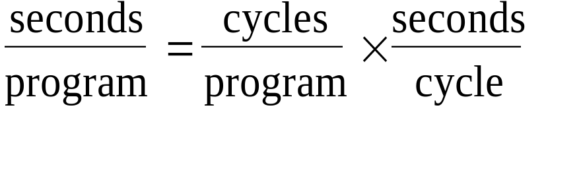
How to Improve Performance
So, to improve performance (everything else being equal) you can either
  reduce the # of required clock cycles for a program or
  decrease the clock period or, said another way,
  increase the clock frequency.

Slide 7
Different numbers of cycles for different instructions
time
Multiplication takes more time than addition
Floating point operations take longer than integer ones
Accessing memory takes more time than accessing registers
Important point: changing the cycle time often changes the number of cycles required for various instructions (more later)
  e.g. memory operations spend time, not cycles
Another point: the same instruction might require a different number of cycles on a different machine
  circuits have been implemented in different ways

Slide 8
Example
A program runs in 10 seconds on computer A, which has a 400 MHz clock. We are trying to help a computer designer build a new machine B, that will run this program in 6 seconds. The designer can use new technology to substantially increase the clock rate, but this increase will affect the rest of the CPU design, causing machine B to require 1.2 times as many clock cycles as machine A. What clock rate should we tell the designer to target?”
Clock cycles_{A} = 10 s * 400 MHz = 4*10⁹ cycles
Clock cycles_{B} = 1.2 * 4*10⁹ cycles = 4.8 *10⁹ cycles
Execution time = # of clock cycles * cycle time
Clock rate_{B} = Clock cycles_{B} / Execution time_{B}
= 4.8 *10⁹ cycles / 6 s = 800 MHz

Slide 9
Now that we understand cycles
A given program will require
  some number of instructions (machine instructions)
  some number of cycles
  some number of seconds
We have a vocabulary that relates these quantities:
  cycle time (seconds per cycle)
  clock rate (cycles per second)
  CPI (cycles per instruction) AVERAGE VALUE!
  a floating point intensive application might have a higher CPI
  MIPS (millions of instructions per second)
  this would be higher for a program using simple instructions

Slide 10
Performance
Performance is determined by execution time
Related variables
  # of cycles to execute program
  # of instructions in program
  # of cycles per second
  average # of cycles per instruction
  average # of instructions per second
Common pitfall: thinking one of the variables is indicative of performance when it really isn’t.

Slide 11
CPI Example
Suppose we have two implementations of the same instruction set architecture (ISA). For some program,
Machine A has a clock cycle time of 10 ns and a CPI of 2.0
Machine B has a clock cycle time of 20 ns and a CPI of 1.2
Which machine is faster for this program, and by how much?
Time per instruction: for A 2.0 * 10 ns = 20 ns
  for B 1.2 * 20 ns = 24 ns
  A is 24/20 = 1.2 times faster
If two machines have the same ISA, which of our quantities (e.g., clock rate, CPI, execution time, # of instructions, MIPS) will always be identical? Answer: # of instructions

Slide 12
# of Instructions Example
A compiler designer has two alternatives for a certain code sequence.There are three different classes of instructions: A, B, and C, and they require one, two, and three cycles, respectively.
The first sequence has 5 instructions: 2 of A, 1 of B, and 2 of C.
The second sequence has 6 instructions: 4 of A, 1 of B, and 1 of C.
Which sequence will be faster? What are the CPI values?
Sequence 1: 2*1+1*2+2*3 = 10 cycles; CPI₁ = 10 / 5 = 2
Sequence 2: 4*1+1*2+1*3 = 9 cycles; CPI₂ = 9 / 6 = 1.5
Sequence 2 is faster.

Slide 13
MIPS
Million Instructions Per Second
MIPS = instruction count/(execution time*10⁶)
Depends on
  clock frequency
  cycles/instruction (may vary even on a single machine)
MIPS is easy to understand but
  does not take into account the capabilities of the instructions; the instruction counts of different instruction sets differ
  varies between programs even on the same computer
  can vary inversely with performance!

Slide 14
MIPS example
Two compilers are being tested for a 100 MHz machine with three different classes of instructions: A, B, and C, which require one, two, and three cycles, respectively.
Compiler 1: Compiled code uses 5 million Class A, 1 million Class B, and 1 million Class C instructions.
Compiler 2: Compiled code uses 10 million Class A, 1 million Class B, and 1 million Class C instructions.
Which sequence will be faster according to MIPS?
Which sequence will be faster according to execution time?

Slide 15
MIPS example
Cycles and instructions
1: 10 million cycles, 7 million instructions
2: 15 million cycles, 12 million instructions
Execution time = Clock cycles/Clock rate
Execution time₁ = 10*10⁶ / 100*10⁶ = 0.1 s
Execution time₂ = 15*10⁶ / 100*10⁶ = 0.15 s
MIPS = Instruction count/(Execution time *10⁶)
MIPS₁ = 7*10⁶ / 0.1*10⁶ = 70 Explanation: Compiler 2
MIPS₂ = 12*10⁶ / 0.15*10⁶ = 80 uses more single
cycle instructions

Slide 16
Benchmarks
Performance best determined by running a real application
  Use programs typical of expected workload
  Or, typical of expected class of applications
  e.g., compilers/editors, scientific applications, graphics, etc.
Small benchmarks
  nice for architects and designers
  easy to standardize
  can be abused
SPEC (System Performance Evaluation Cooperative)
  companies have agreed on a set of real programs and inputs
  can still be abused
  valuable indicator of performance (and compiler technology)

Slide 17
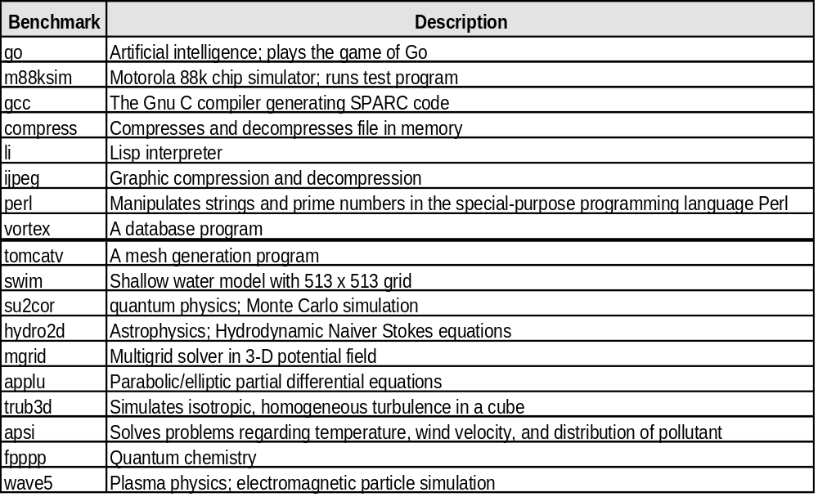
SPEC ‘95

Slide 18
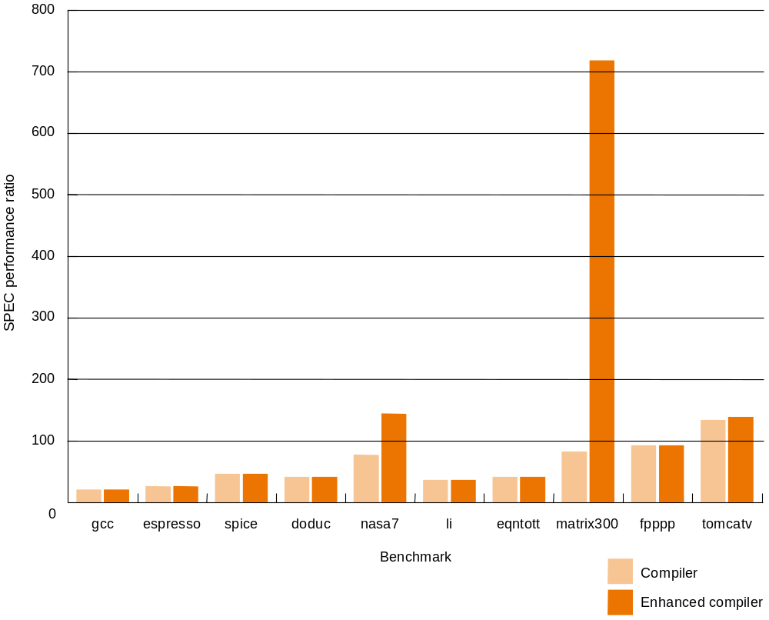
SPEC ‘89
Compiler effects on performance depend on applications.

Slide 19
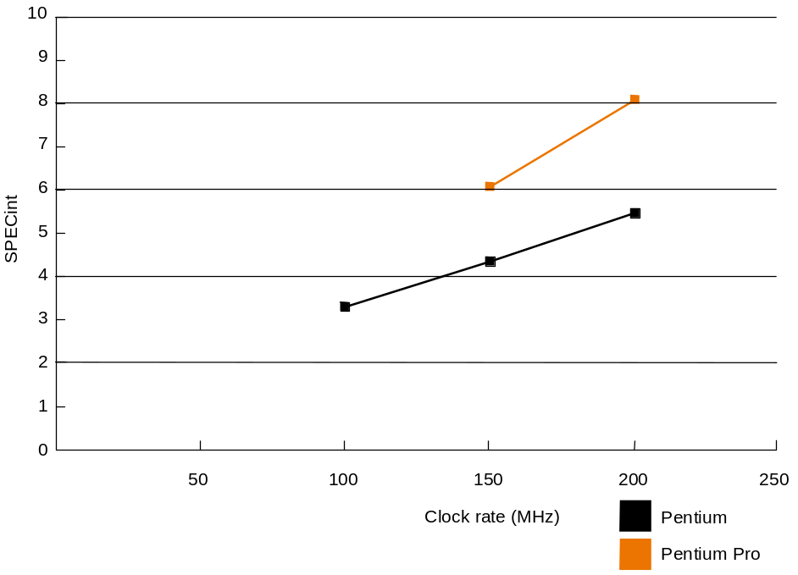
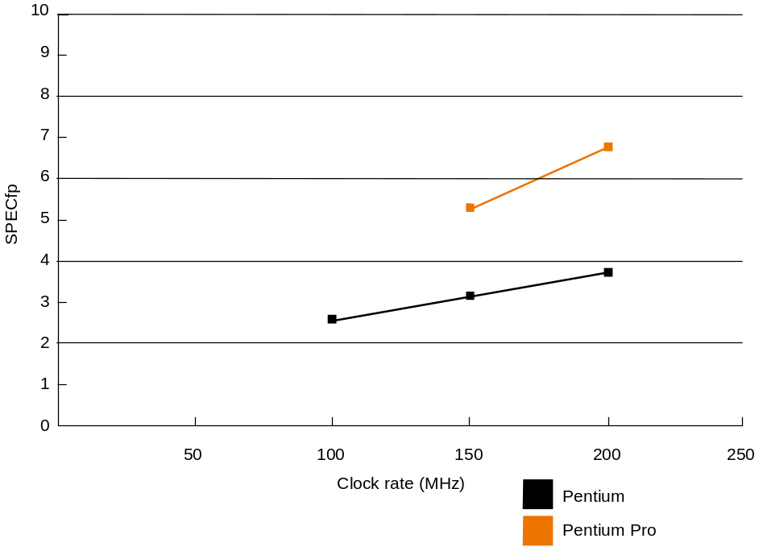
SPEC ‘95
Organisational enhancements enhance performance.
Doubling the clock rate does not double the performance.

Slide 20
Amdahl's Law
Version 1
Execution Time After Improvement =
Execution Time Unaffected +
Execution Time Affected / Amount of Improvement
Version 2
Speedup
= Performance after improvement / Performance before improvement
= Execution time before improvement / Execution time after improvement

Slide 21
Amdahl's Law
n
a
Before:
After:
Execution time: before n + a
after n + a/p
Principle: Make the common case fast
n
a/p
n
+
a
su
=
a
n
+
p

Slide 22
Amdahl's Law
Example:
Suppose a program runs in 100 seconds on a machine, with multiply responsible for 80 seconds of this time. How much do we have to improve the speed of multiplication if we want the program to run 4 times faster?"
100 s/4 = 80 s/n + 20 s
5 s = 80s/n
n= 80 s/ 5 s = 16

Slide 23
Amdahl's Law
Example:
A benchmark program spends half of the time executing floating point instructions.
We improve the performance of the floating point unit by a factor of four.
What is the speedup?
Time before 10s (supposition)
Time after = 5s + 5s/4 = 6.25 s
Speedup = 10/6.25 = 1.6

